Slide 1
Social Media Influence and Domestic Election Interference

Slide 2
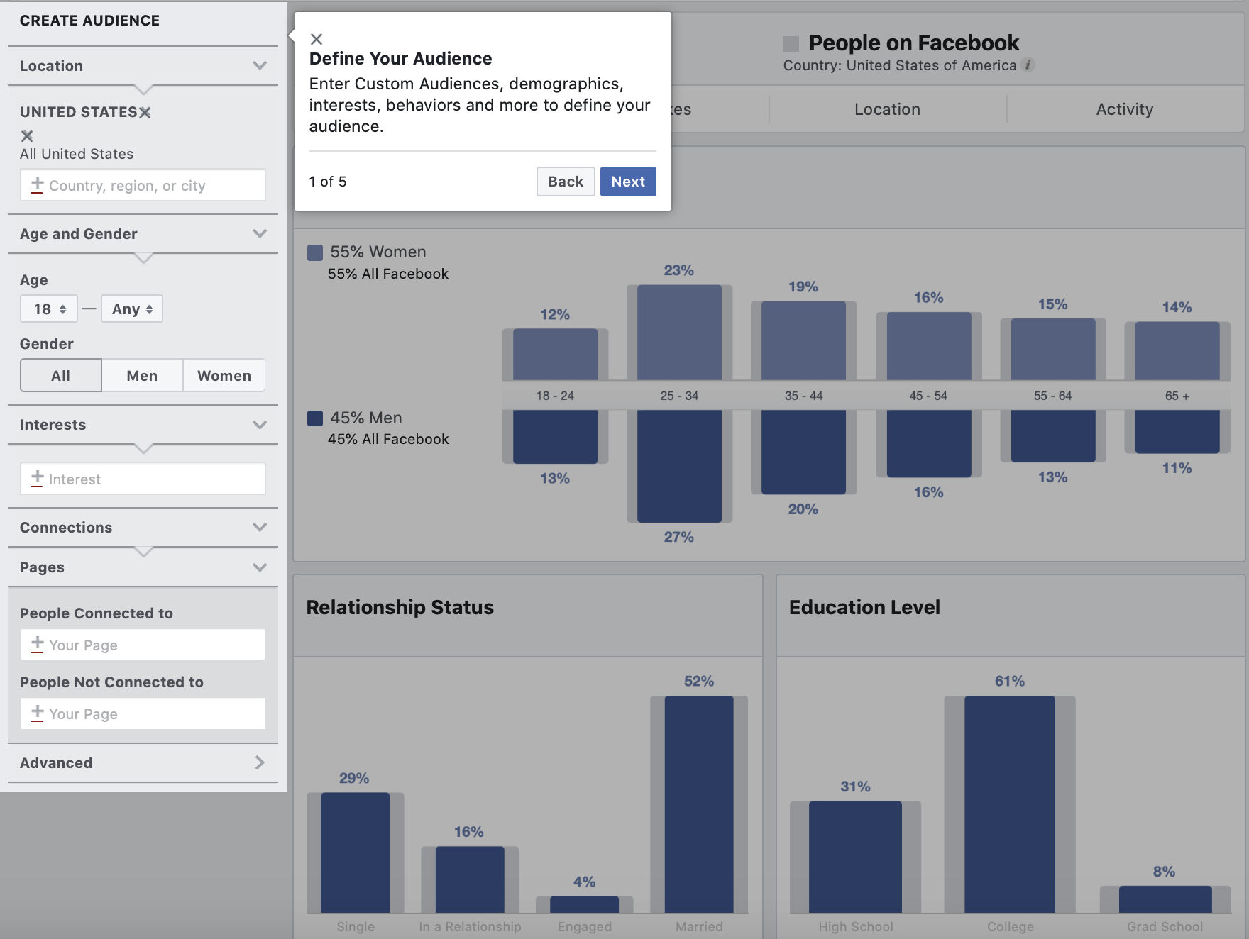
Facebook Audience Insights
Notes:
Domestic election interference

Slide 3
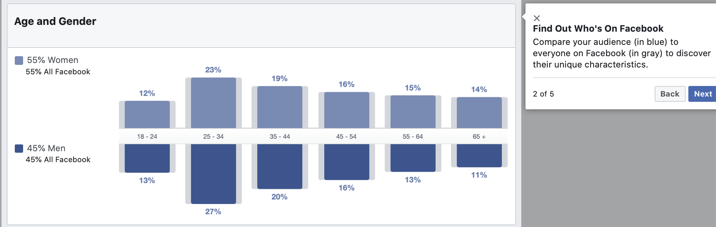
Facebook Audience Insights
Notes:
Domestic election interference

Slide 4
Data/Information
Using Audience Insights, you can get aggregate and anonymous information such as:
Demographics — Age and gender, lifestyle, education, relationship status, job role and household size
Page likes — The top Pages people like in different categories, like women’s apparel or sports
Location and language — Where do people live, and what languages do they speak
Facebook usage — How frequently are people in your target audience logging onto Facebook and what device(s) they are using when they log on
Purchases activity — Past purchase behavior (i.e. heavy buyers of women’s apparel) and purchase methods (i.e., in-store, online)
And you can view this information for three different groups of people:
People on Facebook (the general Facebook audience)
People connected to your Page or event
People in Custom Audiences you’ve already created (an audience made up of your current customers)
Notes:
Domestic election interference

Slide 5
Audience Insights Tool
Insights provide information about your Page's performance, like demographic data about your audience and how people are responding to your posts.
Keep in mind that you can only access data in Page Insights for the last 2 years, and demographic data, such as age, gender and location, are available in Page Insights once there is data for 100 or more people. Pages categorized as a Community Page don't have Insights.
You can use Insights to:
Understand how people are engaging with your Page.
View metrics about your Page's performance.
Learn which posts have the most engagement and see when your audience is on Facebook.

Slide 6
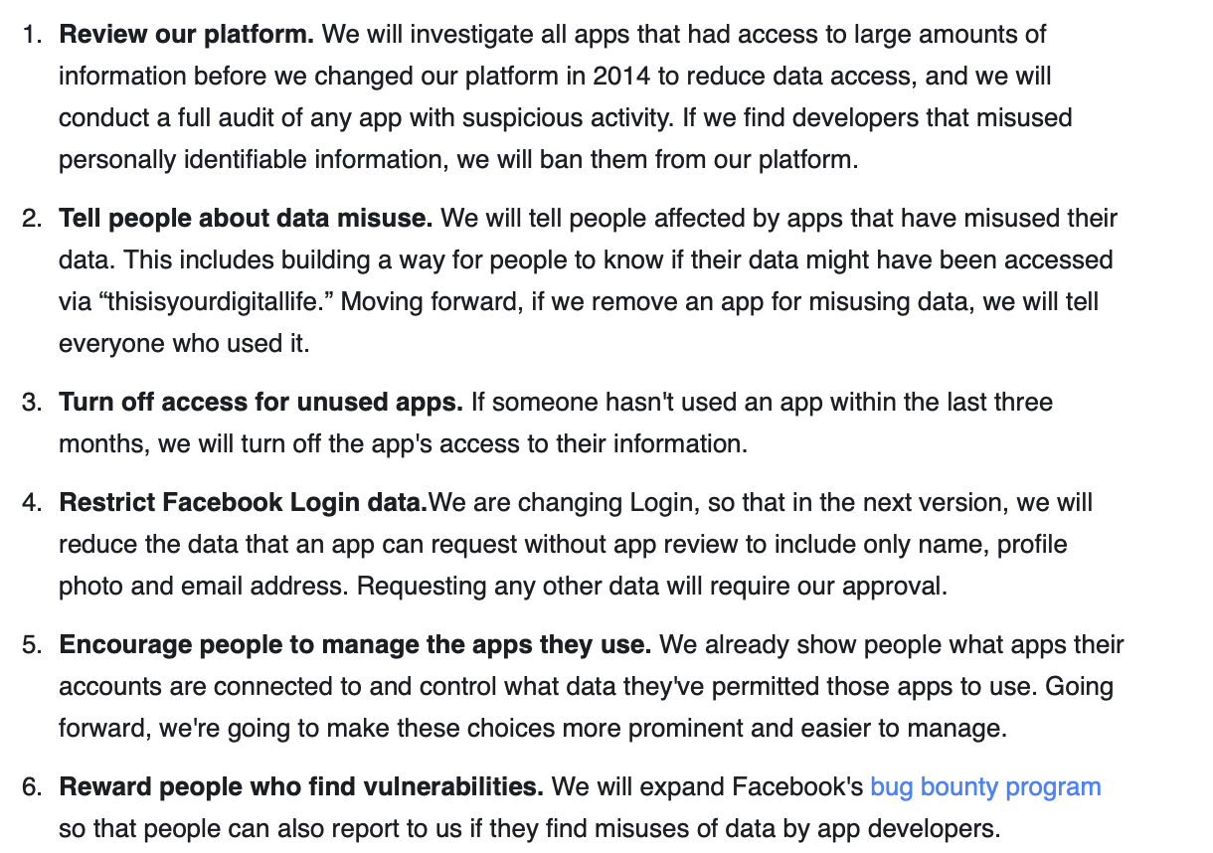
Cracking Down on Facebook Platform Abuse
Notes:
Domestic election interference

Slide 7
Potential Abuse of Facebook Platform and More
People can create many Pages and use the Audience Insights tools to target the advertisements to a specific target
Notes:
Domestic election interference

Slide 8
Audience Insights Tool
Removing some targeting options
We’re committed to protecting people from discriminatory advertising on our platforms. That’s why we’re removing over 5,000 targeting options to help prevent misuse. While these options have been used in legitimate ways to reach people interested in a certain product or service, we think minimizing the risk of abuse is more important. This includes limiting the ability for advertisers to exclude audiences that relate to attributes such as ethnicity or religion.
Expanding advertiser education
We want to help educate advertisers about their obligations under our policies. For over a year, we have required advertisers we identify offering housing, employment or credit ads to certify compliance with our non-discrimination policy. In the coming weeks, this new certification will roll out gradually to all US advertisers via our Ads Manager tool. Advertisers will be required to complete this certification in order to continue advertising on Facebook. We’ve designed this education in consultation with outside experts to underscore the difference between acceptable ad targeting and ad discrimination.
We’ll expand this to advertisers using our other tools and APIs, and those in additional countries, over time.

Slide 9
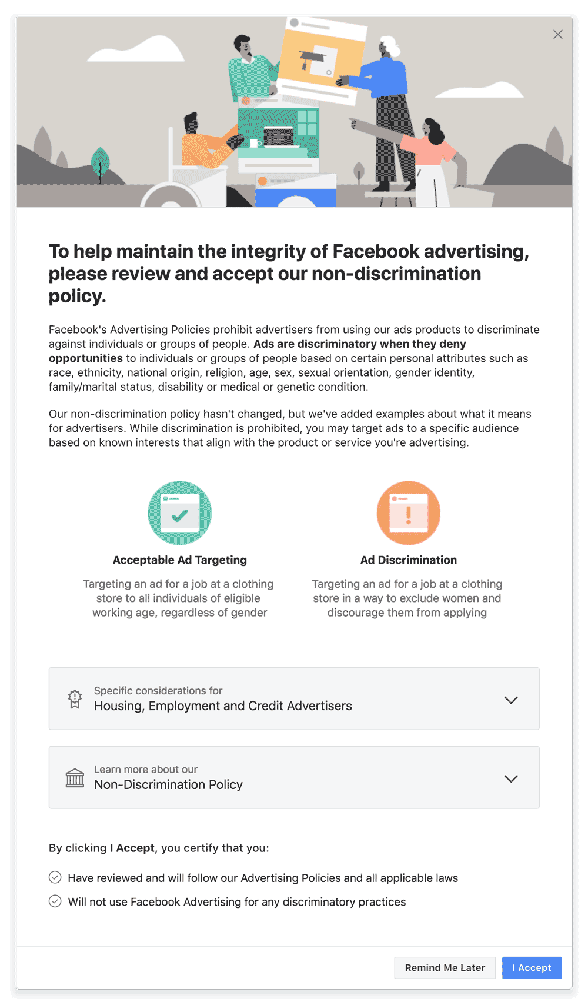

Slide 10
SOURCE FOR NEXT CONTENT
Facebook increases advertiser accountability to prevent future electoral abuse
Source: Campaign Platform
Author: Lindsay Stein
Date: April 6th, 2018
Approximate length: 1 Page(“Short”)

Slide 11
Facebook increases advertiser accountability to prevent future electoral abuse
Anyone who wants to run "issue ads" around political topics being debated in the country will have to be authorized by Facebook, which is a policy the company put in place for electoral ads. Facebook is working with third parties to develop a list of political issues, which will be revised over time.
Facebook is investing in A.I. to help mine out advertisers who are skirting by on this issue, but it realizes "we won't catch every ad that should be labeled, and we encourage anyone who sees an unlabeled political ad to report it.”

Slide 12
SOURCE FOR NEXT CONTENT
Politicians Use Social Media Data to Target Voters
Source: Government Technology/the Pittsburgh Post-Gazette
Author: Rich Lord And Chris Potter, Pittsburgh Post-gazette
Date: May 18th, 2015
Approximate length: 2 Pages(“Short”)

Slide 13
Politicians Use Social Media Data to Target Voters
A spreadsheet from a Washington, D.C.-based political data firm called Aristotle purported to describe where those voters stand on gay rights, gun rights and animal rights; what type of job and level of earnings they have; which magazines and religions they subscribe to; whether they have kids, own homes, do their own remodeling, garden or fish.
Campaign Grid adds data on what you’ve bought online and how you’ve responded to surveys, then sends tailored banner ads and pop-ups to the screen of your phone or computer.

Slide 14
SOURCE FOR NEXT CONTENT
Experts warn the social media threat this election is homegrown
Source: Politico
Author: Nancy Scola(a senior technology reporter for POLITICO Pro)
Date: November 5th, 2018
Approximate length: 2 Pages(“Short”)

Slide 15
Experts warn the social media threat this election is homegrown
Homegrown American trolls are a growing force behind efforts on Facebook and Twitter to suppress turnout, confuse or anger voters, or otherwise spread fake rumors that could tip tight races or shake faith in the results.
More targeted disruption or suppression efforts will appear on Election Day, such as posts that mislead about polling place closing times or discourage people from voting via fake pictures of people being bused into the wrong district. The perpetrators, say experts, range from bored pranksters to partisans executing dirty tricks.
“It can be teenagers messing around, trolls on 4Chan doing it for the lulz, part of a sophisticated campaign, or a mixture of all of them” -Ben Nimmo, an information defense fellow at the Atlantic Council’s Digital Forensic Research Lab.
“It’s much easier to understand what’s happening —and influence what goes on — if you’re in Texas as opposed to St. Petersburg or Tehran,” said Nimmo.
“Let’s say someone puts up a tweet that says ‘The polling place is closed because the school is flooded,’” said David Brody, senior fellow for privacy and technology at the Lawyers’ Committee for Civil Rights Under Law. “That could be factual. Or that could be false information, designed to keep people in that precinct from going to the polls. And it’s really difficult sometimes to vet that in real time.”
While U.S. law and norms restrict foreign activity during elections, removing domestic content exposes the companies to charges that they’re censoring American speech — something they’re eager to avoid in the already tense political atmosphere around the tech industry in Washington. Republicans frequently accuse the internet giants of discriminating against conservative views.

Slide 16
SOURCE FOR NEXT CONTENT
Why the fight against disinformation, sham accounts and trolls won’t be any easier in 2020
Source: Politico
Author: Alexandra S. Levine, Nancy Scola, Steven Overly And Cristiano Lima(reporters/journalists)
Date: December 1st, 2019
Approximate length: 3 Pages(“Short”)

Slide 17
Why the fight against disinformation, sham accounts and trolls won’t be any easier in 2020
“It’s likely that there will be a high volume of misinformation and disinformation pegged to the 2020 election, with the majority of it being generated right here in the United States, as opposed to coming from overseas,” - Paul Barrett, deputy director of New York University’s Stern Center for Business and Human Rights.
“A lot of the disinformation that we can identify tends to be domestic...Just regular private citizens leveraging the Russian playbook, if you will, to create ... a divisive narrative, or just mixing factual reality with made-up facts.”- Nahema Marchal, a researcher at the Oxford Internet Institute’s Computational Propaganda Project.
Americans are allowed, even encouraged, to partake in their own democracy — which makes things a lot more complicated when they use social media tools to try to skew the electoral process. For one thing, the companies face a technical challenge: Domestic meddling doesn’t leave obvious markers such as ads written in broken English and traced back to Russian internet addresses.

Slide 18
There’s often no clear line between bad-faith meddling and dirty politics. It’s not illegal to run a mud-slinging campaign or engage in unscrupulous electioneering.
The line between foreign and domestic can be blurry. Even in 2016, the Kremlin-backed troll farm known as the Internet Research Agency relied on Americans to boost their disinformation.
Experts agree on one thing: The election interference tactics that social media platforms encounter in 2020 will look different from those they’ve been trying to fend off since 2016.
“What we're going to see is the continued evolution and development of new approaches, new experimentation trying to see what will work and what won’t,” said Lee Foster, who leads the information operations intelligence analysis team at the cybersecurity firm FireEye.
Researchers have already observed extensive efforts to distribute disinformation through user-generated posts — known as “organic” content — rather than the ads or paid messages that were prominent in the 2016 disinformation campaigns.
Social media sites have generally granted politicians considerably more leeway to spread lies and half-truths through their individual accounts and in certain instances through political ads.

Slide 19
Potential Experts
Ben Nimmo, an information defense fellow at the Atlantic Council’s Digital Forensic Research Lab
David Brody, senior fellow for privacy and technology at the Lawyers’ Committee for Civil Rights Under Law
Nancy Scola, a senior technology reporter for POLITICO Pro.
Ben Scott, director of policy and advocacy at the Omidyar Network.
Paul Barrett, deputy director of New York University’s Stern Center for Business and Human Rights. He wrote this report on Disinformation and the 2020 Election: How the Social Media Industry Should Prepare.
Nahema Marchal, a researcher at the Oxford Internet Institute’s Computational Propaganda Project.
Lee Foster, who leads the information operations intelligence analysis team at the cybersecurity firm FireEye.
Alexandra S. Levine, a reporter covering the intersection of technology, government and public policy, and she is the author of POLITICO’s popular daily newsletter, Morning Tech.

